Slide 1
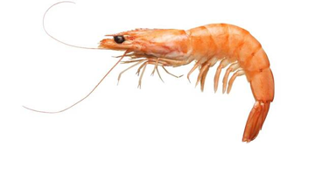
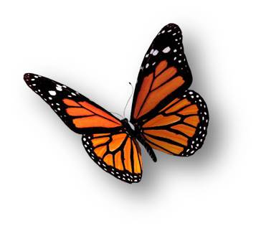
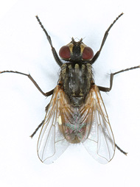
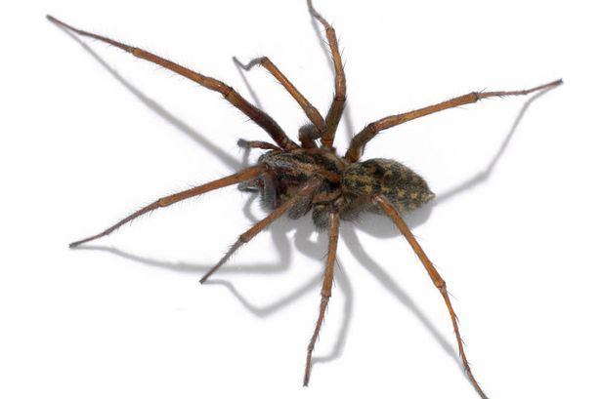
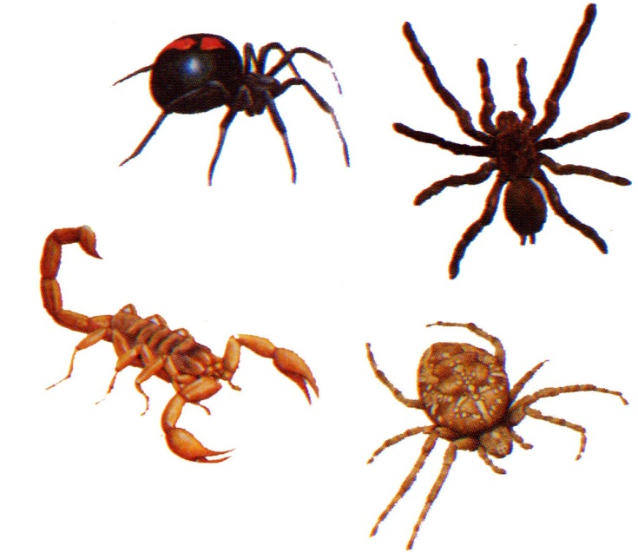
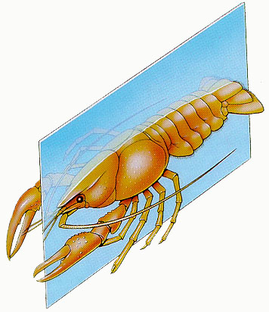
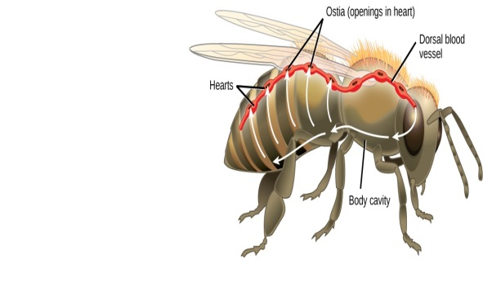
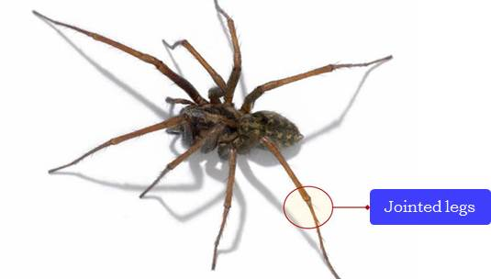
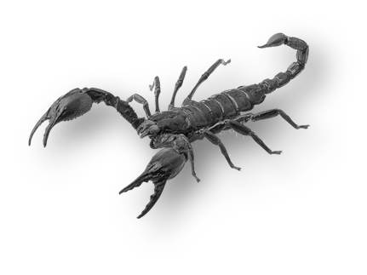
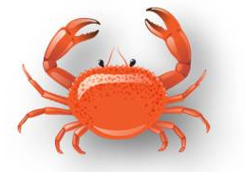
Arthropoda
This is probably the largest group of animals.
Arthros means joints Podas means legs
These animals are bilaterally symmetrical and segmented.
There is an open circulatory system, and so the blood does not flow in well defined blood vessels.
The coelomic cavity is blood-filled.
They have jointed legs
Some familiar examples are prawns, butterflies, houseflies, spiders, scorpions and crabs.

Slide 2
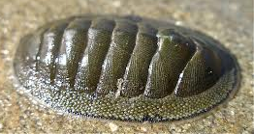
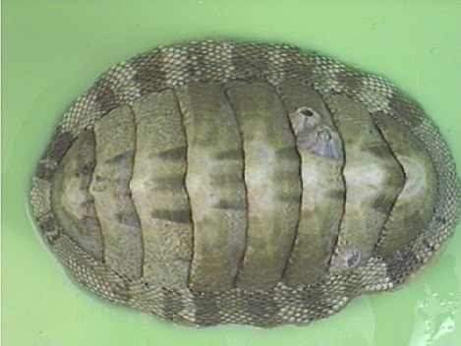
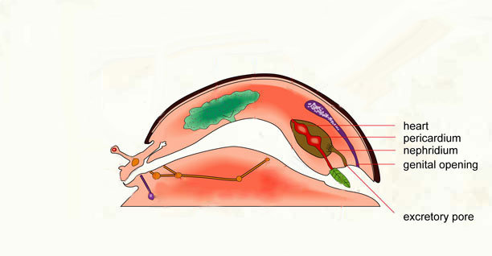
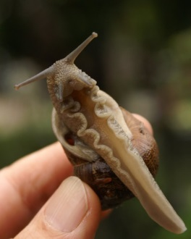
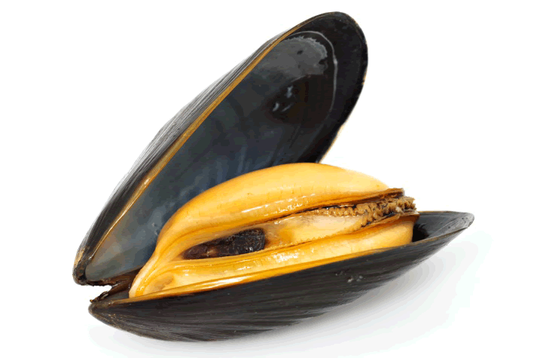
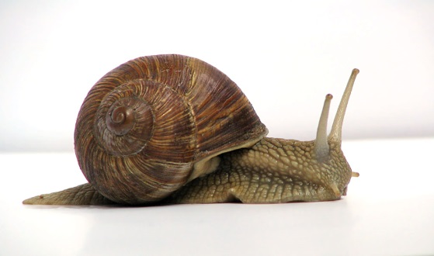
Mollusca
In the animals of this group, there is bilateral symmetry.
Molli means soft-bodied
The coelomic cavity is reduced.
There is little segmentation.
They have an open circulatory system and kidney-like organs for excretion.
These is a foot that is used for moving around.
Examples are snails and mussles.

